Slide 1
Almotahida Education Group

Slide 2
Almotahida Education Group
Almotahida Education Group, established in 1997, is a provider of turnkey education solutions for K 12 - and vocational schools, lifelong learning centers and public libraries. Additionally, we can develop proprietary training workshops for your school or organization.

Slide 3
What We do?
End-to-end education solutions, whether you’re starting new or integrating with current systems.
Investing in the Future: Innovation in Education or integrating with current systems Customized or fully localized print, digital and interactive curriculum in any subject, Arabic or English
Partnerships with innovative technology and educational content providers from around the world, including a global leader in immersive virtual labs
Teacher and administrator training, using research based, blended model strategic professional

Slide 4
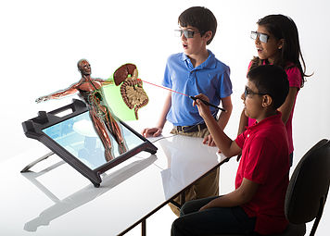
Products
Virtual Labs
Almotahida Education Group is bringing immersive STEM learning to the region, providing virtual labs ,which allows students to interact with objects and really understand the science behind them. With Virtual Labs, students can learn highly engaging tasks that are often too complex, expensive and/or dangerous for the classroom.

Slide 5
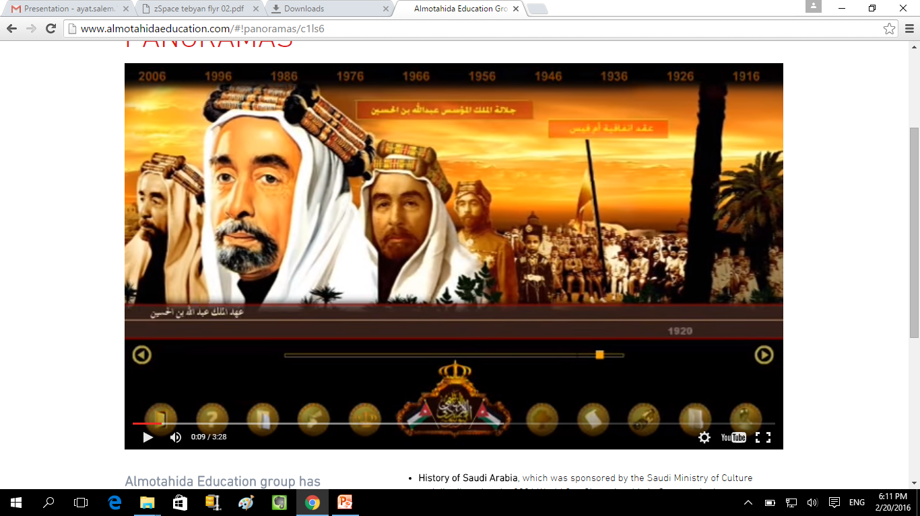
Products
Panoramas
Almotahida Education group has developed several interactive timeline panoramas, which displays historic events in a way that contains a wealth of information, illustrated with both archival and artistic depth.

Slide 6
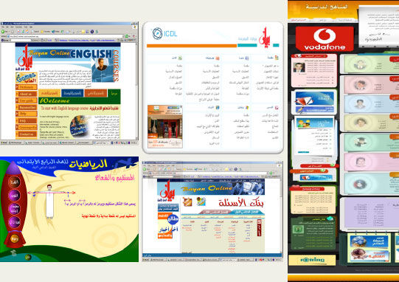
Products
Bayan Education Gateway
Bayan Online is an Arabic education portal launched in 2004. With a focus on Arabic KG1-12 curricula and lifelong learning, Bayan Online has a community forum almost 100,000 members strong.

Slide 7
Academic Digital Library
For universities
More than 35,000 electronic reference books
More than 1200 scientific periodicals
Full papers for more than 100 scientific conferences
Press archive for more than 500 million articles, reports and press analyses
Collection of official Arabic newspapers
For Schools (K to 12)
E-Library for more than 5000 books
Selection of audio books
Dictionaries and encyclopedic glossaries
Integrated geographic encyclopedia
Historical Panoramas
Library of Arabic Literature and Poetry
Archive including more than 5,000,000 encyclopedic media and general information materials

Slide 8
Smart Phone Edutainment Content
Educational Objects
Educational Entertainment
Interactive Experiments
Educational Encyclopedias
Dictionaries & glossaries
School Curricula

Slide 9
Smart Phone Edutainment Content

Slide 10
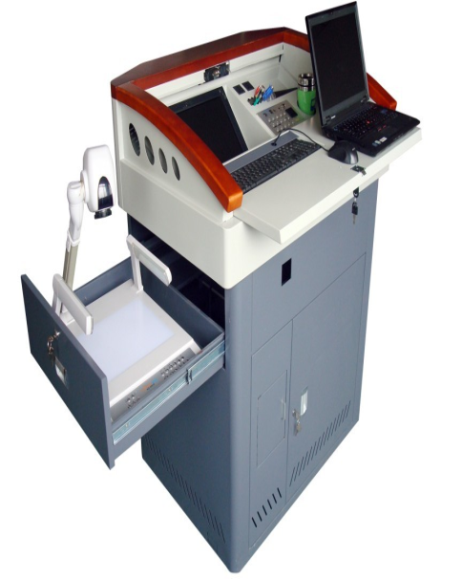
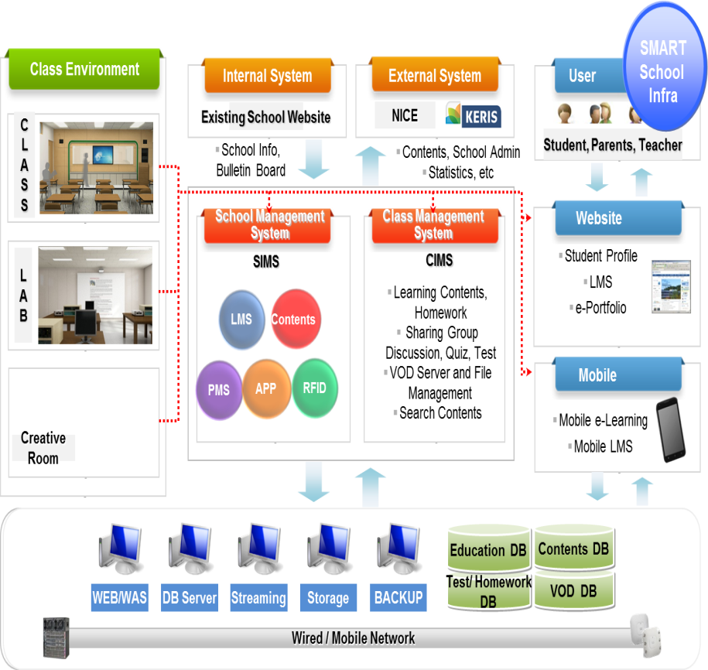
Smart Learning Turnkey Solutions
Virtual laboratories
Teaching podium
Smart school solutions
Smart bus
Smart studios

Slide 11
Smart Education Solutions

Slide 12
Smart School Overview
(Click To Play)

Slide 13
Almotahida for Training
The Almotahida for training is one of an excellence and leadership unit in the Almotahida Group for Education. It has being presented and a series of successes in Arabic field of teaching which give us the ability to offer Almotahida for Training confidently as a capable institution to provide training development and services in the Arab Region
Almotahida includes training for a number of active centers that make up the training modules homogeneous and integrated supply the educational process eligible competencies, which leads the helm of educational development and academic performance actor in educational institutions, and we have our field to offer integrated training system includes kindergartens, public education, and the development of performance in universities, and higher education institutions

Slide 14
Almotahida for Training

Slide 15
Almotahida for Training
Training and Educational Development Center
Performance Development Center in Universities
Center for Continuing Education
Arab Educational Center for Non-Native Speakers
Vocational Training Center

Slide 16
Affiliations and Partnerships

Slide 17
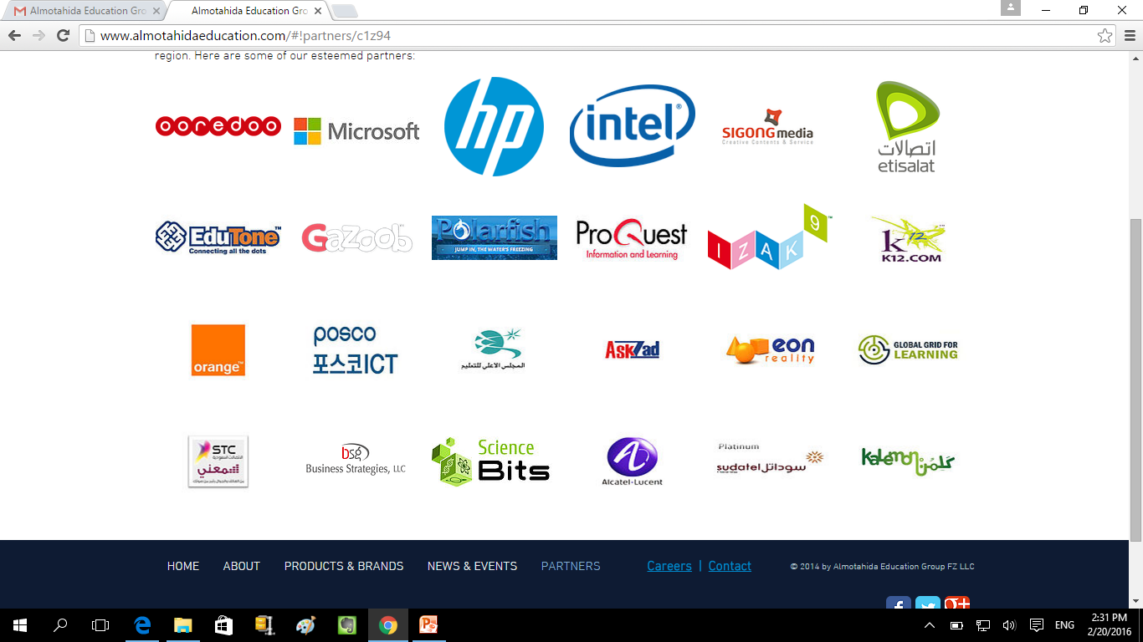
Strategic Partnerships with Industry Leaders

Slide 18
Erasmus+ Team
Eng. Ayat Salem (Contact Person) | Masters of e-Business, specialist in cloud computing .Bsc. in Computer engineering from Al-Balqa Applied University (2009). she is Freelancer Project Manager building web and mobile apps from December 2013. she was Quality Assurance Engineer at InCube Company, Amman Office from May 2010 to August 2013. she was Computer Trainer in Halaqat Ta'aleem Program for Iraqi &Jordanian youth, with Amideast and USAID, from August 2007 to August 2008. she was Trainer in (TOT) for Trainers of second Link of Halaqat Ta'aleem Project 2007

Slide 19
Erasmus+ Team
Dr. Fahmi Al Balawneh | PhD. in Curriculum and Instruction, Mathematics from Amman Arab University (2007). he is Executive Manager of Almotahida Education Group (1/11/2014- present). he was Academic Consultant and evaluator for the curriculum Development Department in Almotahida Education Group (17/5/2014- 30/10/2014). he was Academic assessor in Association of Queen Riana Al Abdulla Award for Excellence in Education(2014). he was Associate, CEO and General Manager in Madameen for Human Resources Development (2013- 2014).

Slide 20
Contact us
E: info@almotahidaeducation.com
W: www.almotahidaeducation.com

Slide 21
Thanks

